Slide 1
Animal Shelter Outcomes
By: Eric Liao

Slide 2
Glossary
Acquiring the Data
Hypothesis
Exploratory Analysis
Dummy Variables
Creating an Algorithm for Age
More Analysis
Cleaning Up my Data
Machine Learning
Machine Learning II
Machine Learning III
Machine Learning IV
Next Steps
Special Thanks
Questions

Slide 3

Acquiring the Data
I will be looking at data from a Kaggle competition on Animal Shelter Outcomes. The "Outcomes" column has been removed from the test set, and I will create a model (from my train set) to see how accurately I can predict the missing outcomes. In order to complete this task, I will have to be picky on what categories I build my model out of, and see what yields the best results.

Slide 4
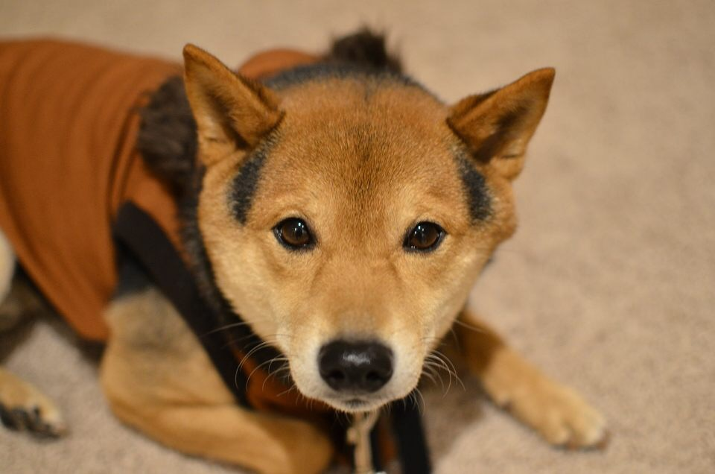
Hypothesis
I believe that "age" will play the most important role in correctly predicting the outcome of an animal shelter. Since most adopters prefer a younger puppy instead of an elder dog, age should be important in predicting adoptions and deaths.

Slide 5
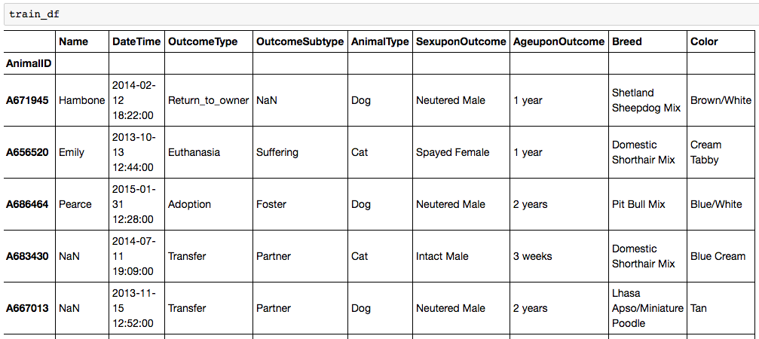
Exploratory Analysis
Mostly categorical, so I’ll have to create dummy variables.
Age is not in the same unit.

Slide 6
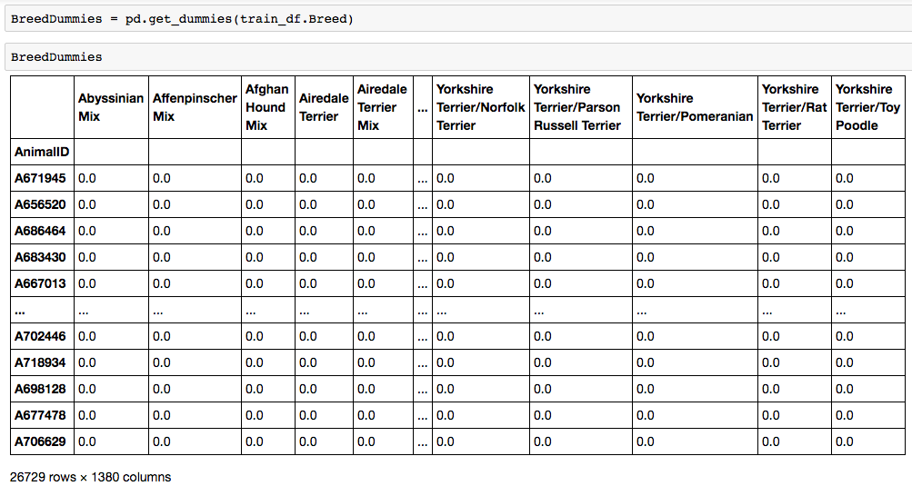
Creating Dummy Variables

Slide 7
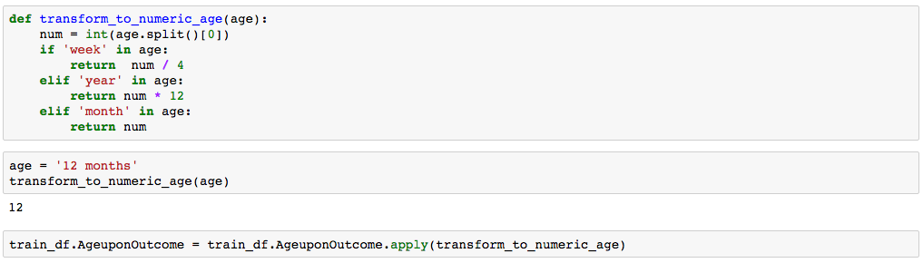
Creating an Algorithm for Age
Out of all my categories, I see that Age is the only one that has continuous variables. The problem is that not all of the dog's ages are in the same unit (year, month, day), so I need to create an algorithm to convert all ages to the same unit (month).

Slide 8
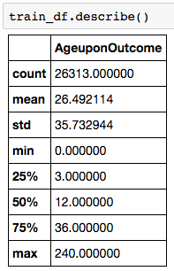
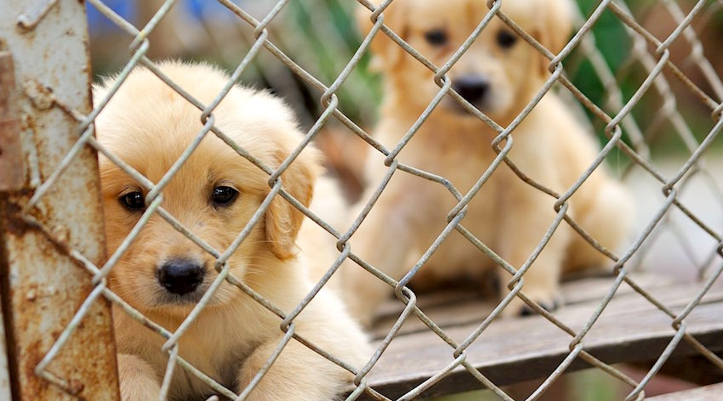
More Analysis

Slide 9
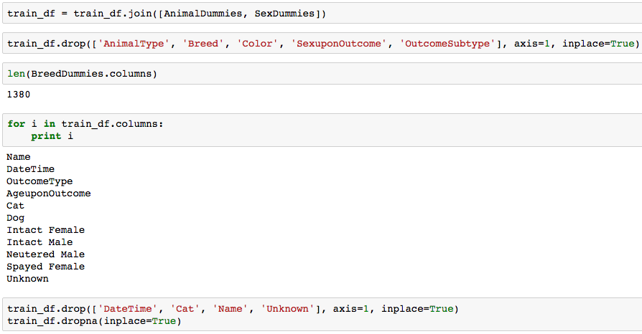
Cleaning Up the Data

Slide 10
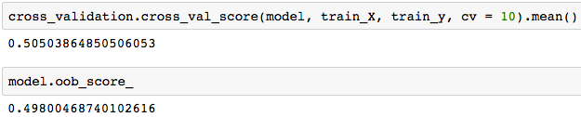
Machine Learning
Since most of my data is categorical, there's no real way for me to do a linear regression model. Instead, I will be using random forest for my modeling.
My original random forest model actually had a higher cross validation score than my final. Since I am now using 20 estimators, instead of the original 10, I'm okay with this slight discrepancy, as my results should be more in tune with the true population.

Slide 11
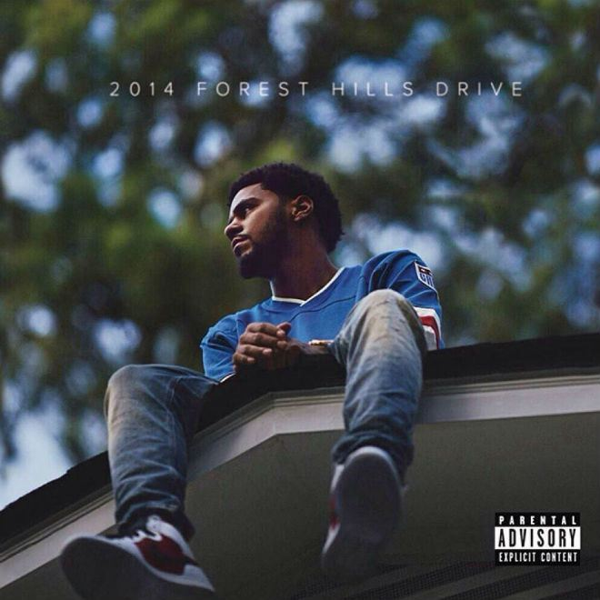
Random Forest

Slide 12
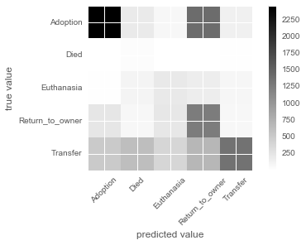
Machine Learning II
Happy with my random forest model, I wanted to see if there were certain outcomes I could predict better than the others.

Slide 13
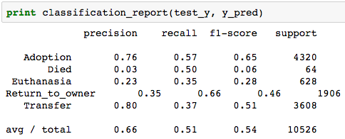
Machine Learning II (Cont’d)

Slide 14
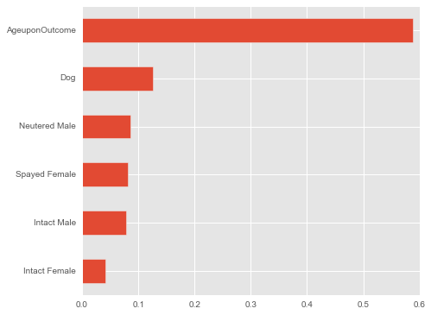
Machine Learning III
Now that I know what outcomes I can better predict, I wanted to see which features play the most importance on predicting a correct outcome.

Slide 15
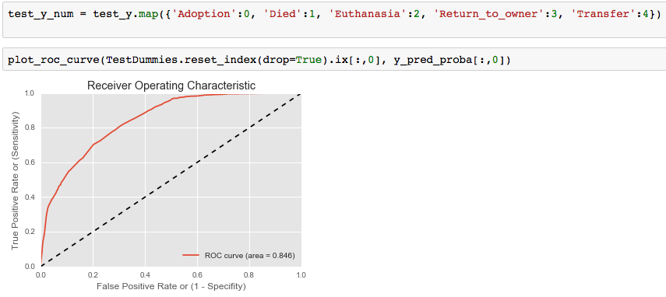
Machine Learning IV
I will be using a ROC curve to determine my true positive rate in predicting the different outcomes.

Slide 16
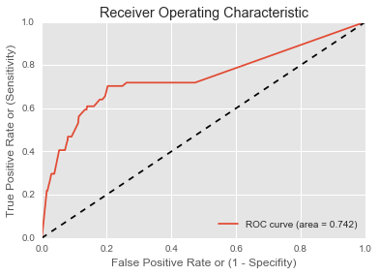
Machine Learning IV (Died)

Slide 17
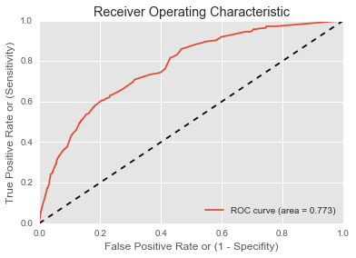
Machine Learning (Euthanasia)

Slide 18
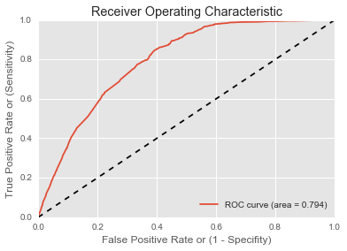
Machine Learning IV (Return to Owner)

Slide 19
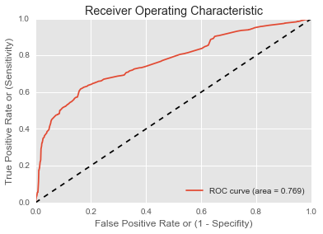
Machine Learning IV (Transfer)

Slide 20
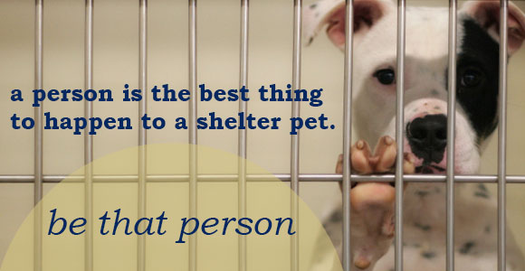
Next Steps
Acquire more data.
Re-run my models to include cats.
Look into the importance of other features for correctly predicting outcome.

Slide 21
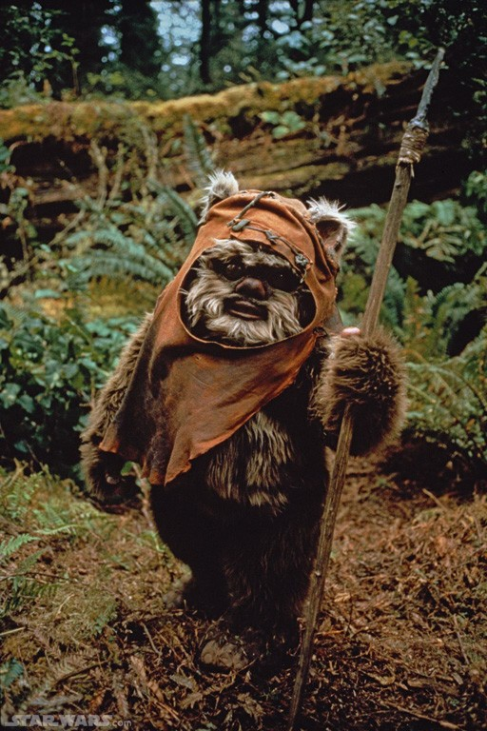
Special Thanks!
Ivan Corneillet, Jeremiah Gaw, & Azi Hussain
SF-DAT-21

Slide 22
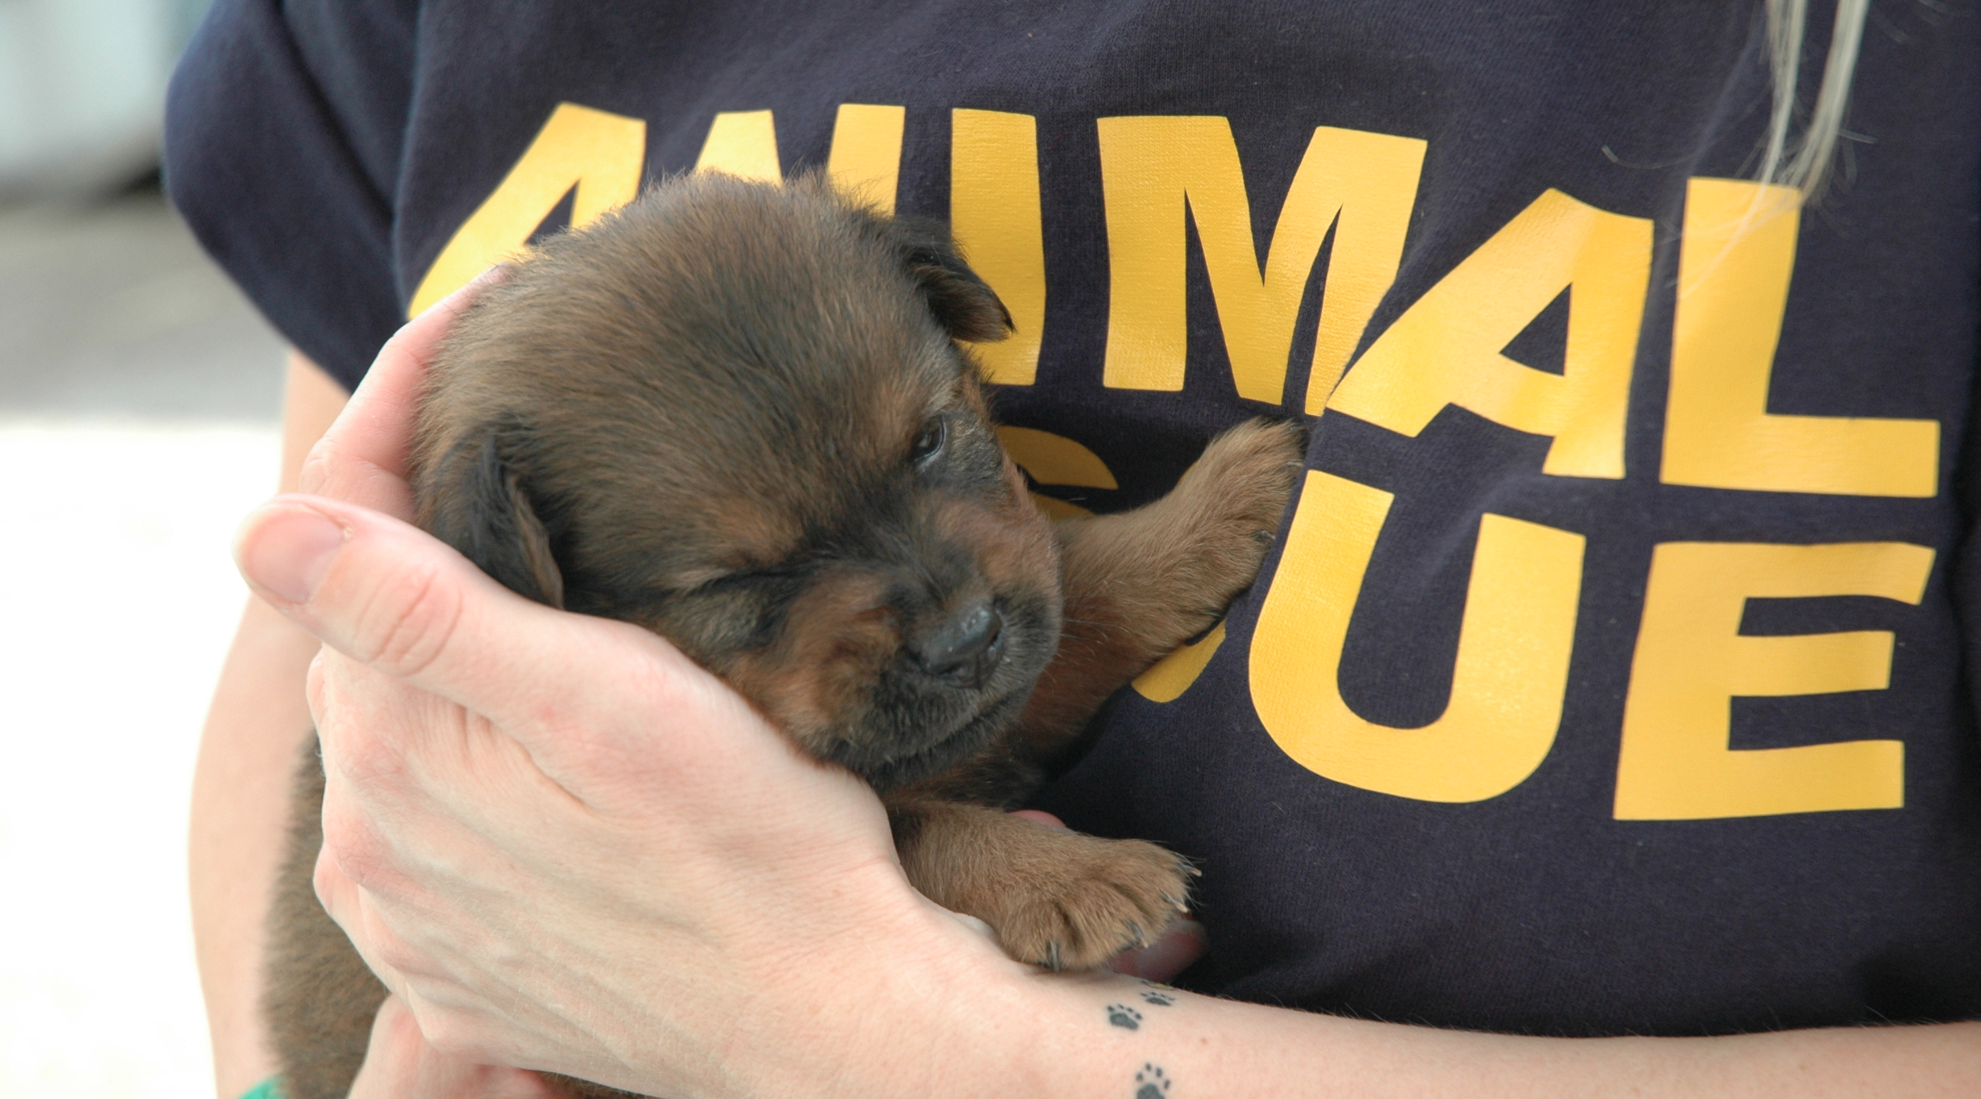
Questions?

